Slide 1
The Interspeech Science Quiz 2005
answers and winner
Organized by Gerrit Bloothooft, Rolf Carlson, Julia Hirschberg, Lin-shan Lee, Isabel Trancoso, Michael Wagner

Slide 2
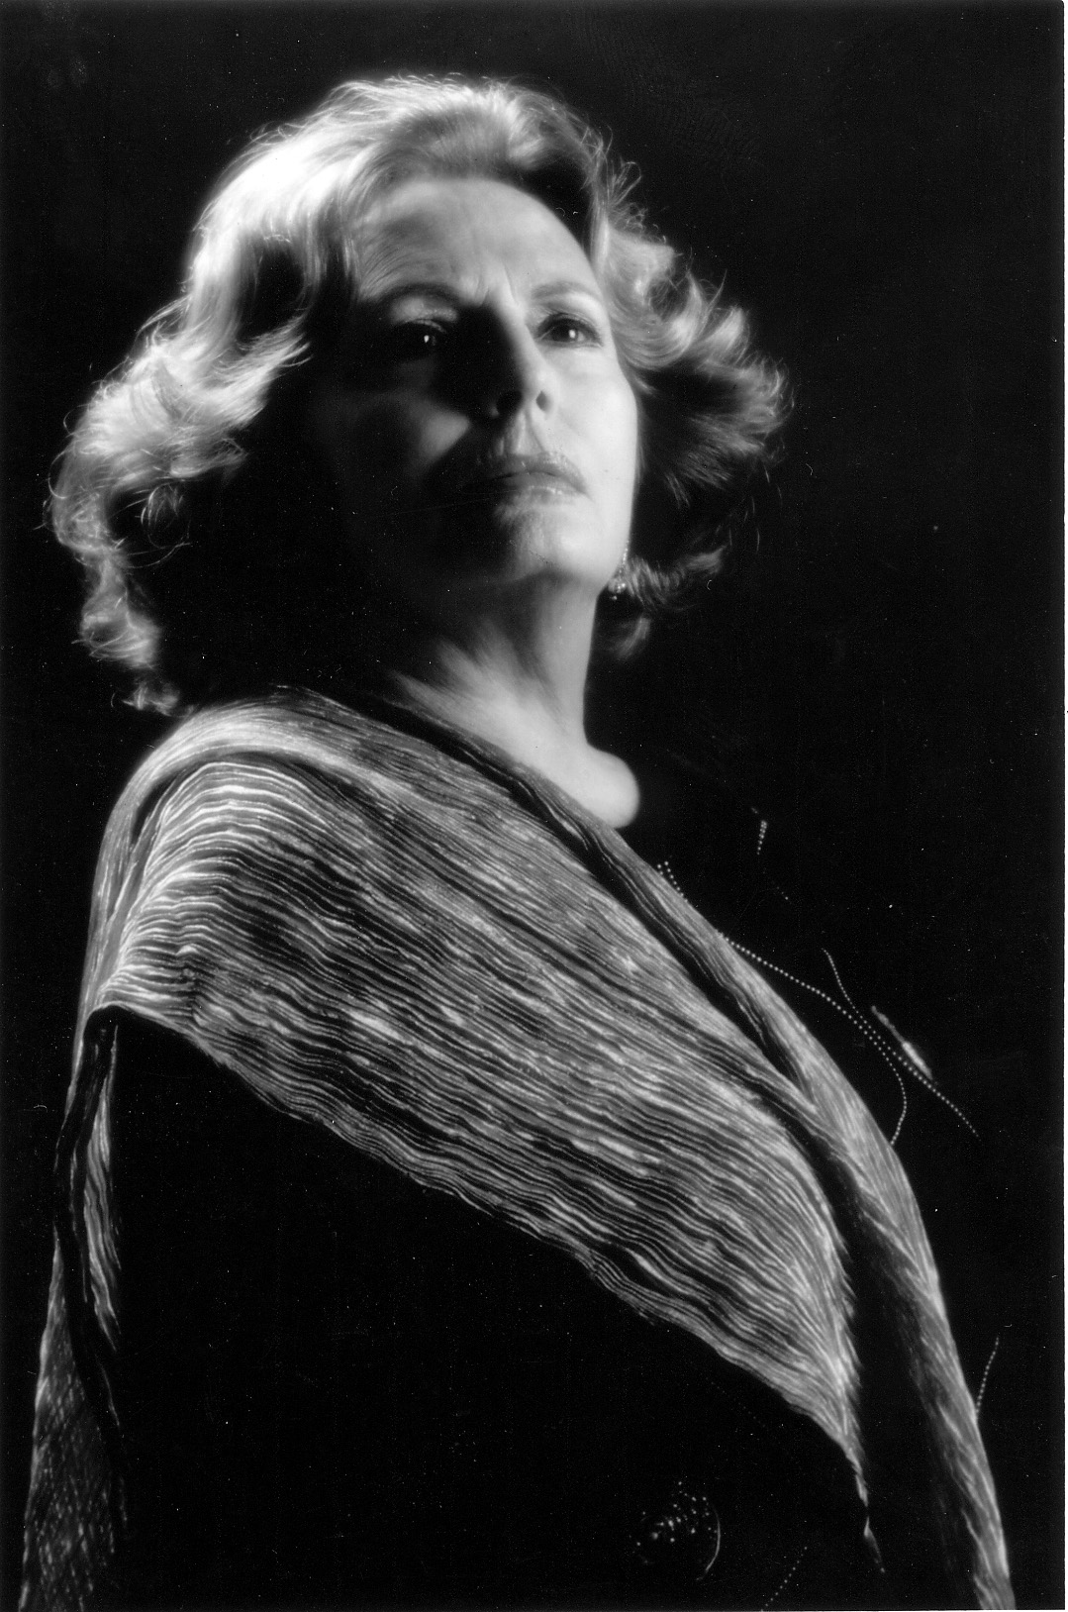
Interspeech Science Quiz
1. Which type of singing is involved in the famous Lisbon fado?
Bel Canto
falsetto voice
chest voice
Gerrit Bloothooft, Utrecht University, The Netherlands
Amalia Rodrigues
Notes:
Bel Canto is the Italian type of art song. In fado singing the speaking register (chest voice) is used. This is also the case in female fado singing, although in Western art song females mainly sing in falsetto register.

Slide 3
Interspeech Science Quiz
2. In general, in continuous speech, the duration variability of vowels due to contexts, compared to that due to speakers is
larger
smaller
about the same
Crystal T.H., and House, A.S., (1988). “The duration of American-English vowels: An Overview,” Journal of Phonetics, 16, 263-284.
Sorin Dusan, Rutgers University, USA
Notes:
In a study based on connected discourse of six speakers, the duration variability of long vowels due to different contexts is about 38% whereas that due to different speakers is about 11%.

Slide 4
Interspeech Science Quiz
3. Which statement is true?
older speakers vary their speech tempo more than younger speakers do
younger speakers vary their speech tempo more than older speakers do
tempo variations are equally large for older and younger speakers
Hugo Quené (2005), “Modeling of Between-Speaker and Within-Speaker Variation in Spontaneous Speech Tempo”, Proc. Interspeech2005, Lisbon, #1169
Hugo Quené, Utrecht University, The Netherlands

Slide 5
Interspeech Science Quiz
4. Which ratio describes the relation between interaural time and intensity differences in binaural localization of a sound source?
< 200 μs/dB
> 200 μs/dB
interaural time and intensity differences are not comparable
M. Dickreiter (1987), Handbuch der Tonstudiotechnik Band I,
K.G. Saur Verlag, Munich.
Sascha Fage, Technical University Berlin, Germany
Notes:
The ratio has a wide range as it depends on loudness, angle of incidence, and spectral composition of the sound source.

Slide 6
Interspeech Science Quiz
What is never used by an opera singer to be heard over orchestral music?
head and chest resonances
reshaping the vocal tract to tune F0 and F1
reshaping the vocal tract to combine F3, F4 and F5
J. Sundberg, ``The acoustics of the singing voice,'' Scientific American, pp. 82-91, March 1977.
Miguel Arjona Ramírez, University of São Paulo, Brasil

Slide 7
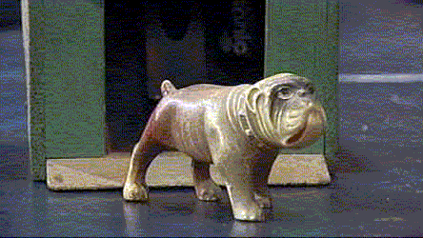
Interspeech Science Quiz
What character featured in a commercial product that was offered and sold in the US in the 1910's and designed to respond to speech input?
a human
a dog
a parrot
David, E., and Selfridge, O., "Eyes and Ears for Computers". Proc. IRE 50: 1093-1101, 1962. Nelson Morgan, ICSI, Berkeley, USA
Notes:
The device was Radio Rex, which consisted of a toy dog in a doghouse. It had a 500 Hz resonance, and an electromagnet that held back the dog that otherwise would be pushed forward by a compressed spring; when there was enough 500 Hz energy (for instance, when a user said "Rex" to the dog) the electromagnet's connection would be broken and the dog would be pushed out. Some of these are still around (and have been sold on E-Bay).

Slide 8
Interspeech Science Quiz
7. Which of the following is not an application of Hidden Markov Models?
acoustic modeling of bird song
analysis of neuronal activity
modeling of palindromic sequences
HMMs are stochastic regular grammars, which cannot describe sequences like AABBAA Carlos Troncoso Alarcon, Kyoto University, Japan

Slide 9
Interspeech Science Quiz
8. The affective tone of musical melodies/chords and speech prosody are often self-evident (if difficult to quantify). What types of 3-tone triads are consistently rated as highest in "tension" by both musicians and non-musicians?
diminished triads
minor triads
augmented triads
L.A. Roberts, Acustica 62, 163, 1986 N.D. Cook, Tone of Voice and Mind, Benjamins, Amsterdam, 2002
Norman D. Cook , Kansai University, Osaka, Japan

Slide 10
Interspeech Science Quiz
What area is addressed in the PhD-thesis of Julia Hirschberg, vice-president of ISCA?
phonetics
history
psychology
Julia Hirschberg, "A Social History of Puebla de los Angeles, 1531-1560“, Ph.D. Dissertation, University of Michigan, 1976
Gerrit Bloothooft, Utrecht University, The Netherlands
Notes:
Also Julia Hirschberg, "Social Experiment in New Spain: A Prosopographical Study of the Early Settlement at Puebla de los Angeles, 1531-1534," Hispanic American Historical Review 59:1(1979): 1-33

Slide 11
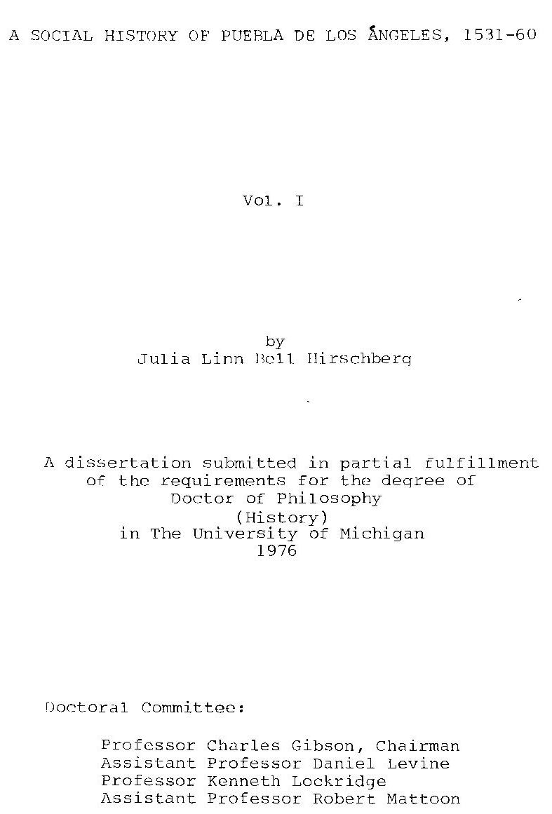
Cover page !

Slide 12
Interspeech Science Quiz
Who utter more disfluencies, especially filled pauses or fillers, in spontaneous conversations?
female speakers
male speakers
no difference between male and female speakers
From the Special Session on Age and Gender, Interspeech 2005:
Martine Adda-Decker and Lori Lamel, "Do speech recognisers prefer female speakers"
Diana Binnenpoorte, Christophe Van Bael, Els den Os, Lou Boves, "Gender in every-day speech and language: a corpus-based study", and
Schriberg, E., "To 'errr' is human: ecology and acoustics of speech disfluencies", Journal of the International Phonetic Association, 31/1, pp. 153-169, 2001
Els den Os, Radboud University, Nijmegen, The Netherlands

Slide 13
Interspeech Science Quiz
11. If during production of a long, sustained vowel /a/ one is suddenly pushed on the chest, what happens immediately after the push?
F₀ increases, SPL remains constant
F₀ remains constant, SPL increases
Both F₀ and SPL increase
[graph?]
Helmer Strik (1994). “Physiological control and behaviour of the voice source in the production of prosody”. Ph.D. dissertation, University of Nijmegen. Helmer Strik, Radboud University, Nijmegen, The Netherlands
Notes:
Psub (and thus also Ptrans) suddenly increase, and consequently F0 suddenly increases. SPL also increases (but this is less salient). (immediately, because after some time there also may be an effect of the contraction of muscles, of larynx etc.).

Slide 14
Interspeech Science Quiz
12. To train an automatic speech recognizer, large amounts of speech are used, say 25,000 hours of speech. How many hours of speech does a human roughly hear in a lifetime?
more
less
about the same
Moore, Roger K. 'There's no data like more data (but when will enough be enough?)', Proc. Inst. of Acoustics Workshop on Innovation in Speech Processing, IoA Proceedings vol.23, pt.3, pp.19-26, Stratford-upon-Avon, 2-3 April (2001).
Helmer Strik, Radboud University, Nijmegen, The Netherlands
Notes:
Roger Moore concluded that, as a rule of thumb, a two year-old has heard 1000 hours of speech, a 10 year-old has been exposed to 10,000 hours of speech, and a 70 year-old has heard 100,000 hours of speech.

Slide 15
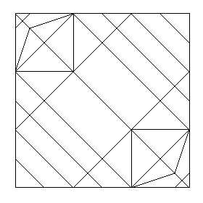
Interspeech Science Quiz
13. In origami, the art of paper folding, a crease pattern is a picture showing the creases corresponding to an origami model, when it is completely reopened. The crease pattern
in the figure corresponds to an origami model showing
vocal folds
the vocal tract
talking lips
Roberto Gretter, ITC-IRST, Trento, Italy

Slide 16
Interspeech Science Quiz
14. Who said: “Every time I fire a linguist, my system's performance goes up”
Fred Jelinek
Victor Zue
Wolfgang Wahlster
Louis ten Bosch, Radboud University, Nijmegen, The Netherlands

Slide 17
Interspeech Science Quiz
15. The maximum number of vowels in a language is
unlimited
determined by the just noticeable difference of complex tones
determined by the phonological structure of that language
There is a perceptual limitation, which excludes answer a, while answer c is a circular reasoning.
Louis ten Bosch, Radboud University, Nijmegen, The Netherlands
Notes:
The maximum number of vowels would determine the phonological structure.

Slide 18
Interspeech Science Quiz
16. All of the following mammal species have a lower than typical larynx position for their vocalizations. In two of them the lowering of the larynx is permanent. Which species only lowers the larynx temporarily during vocalization?
humans
red deer
dogs
W.Tecumseh Fitch, keynote at ICSLP-2002, pp 1-8.
Michael Wagner, University of Canberra, Australia
Notes:
Many mammal species, including dogs, lower the larynx temporarily during vocalizations. A few species, including humans and red deer, have a larynx that is permanently lower than the larynx resting position in typical mammals. The evolutionary benefit of the permanent lowering of the larynx in those species is thought to have been a correlation between formant frequencies and perceived body size. Hence a lower larynx enabled an individual, particularly a male, to convey an exaggerated impression of its body size in order to attract females and deter rival males.

Slide 19
Interspeech Science Quiz
Thanks to all who submitted questions and those who took the effort to find the answers
and the winner is

Slide 20
Interspeech Science Quiz
winner

